Slide 1
Fingerprint based Attendance system
By: Nehal Bandal (B120053020)
Sankalp Gupta (B120053069)
Hemant Dukare (B120053072)

Slide 2
Objective
Designing a fingerprint based student attendance management system that manages records for attendance in institutes like PICT.

Slide 3
Introduction
Biometric identification system are widely used for unique identification of humans mainly for verification & identification.
Biometrics is used as a form of identity access management and access control.
So use of biometrics in student attendance management system is a fast and efficient approach.
There are many types of biometric systems like fingerprint recognition, face recognition, voice recognition, iris recognition, palm recognition etc. In this project, we used fingerprint recognition system.

Slide 4
Background
Every organization whether it be an educational institution or business organization, it has to maintain a proper record of attendance of students or employees for effective functioning of organization.
Designing a better attendance management system for students so that records be maintained with ease and accuracy was an important key behind motivating this project.
This would improve accuracy of attendance records because it will remove all the hassles of roll calling and will save valuable time of the students as well as teachers.

Slide 5
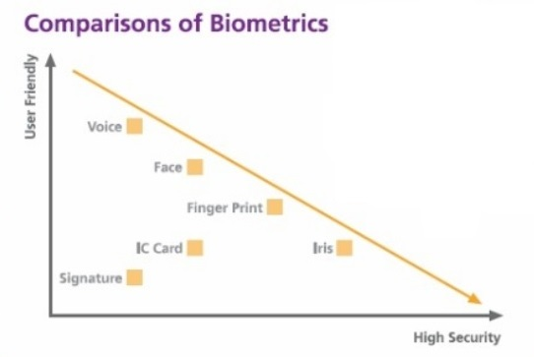
Why Fingerprint?

Slide 6
Unique identification
The fingerprint for every person is unique. So, this gives us secure and efficient way of identifying a person.
Easy to register the fingerprint of all students
It is less complex to process the fingerprint templates than other biometric currently used in identification/verification.
Secured protection against tampering
The student attendance system based on the fingerprint identification software is secured against digital tampering. Unless a student is not registered, the student attendance system will never accept the proxy attendance.

Slide 7
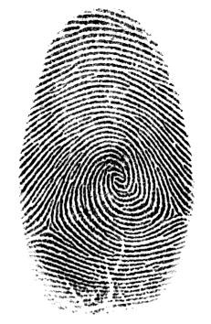
What Is Fingerprint?
Skin on human fingertips contains ridges and valleys which together forms distinctive patterns. These patterns are called FINGERPRINTS.
However, shown by intensive research on fingerprint recognition, fingerprints are not distinguished by their ridges and furrows, but by features called Minutia, which are some abnormal points on the ridges.

Slide 8
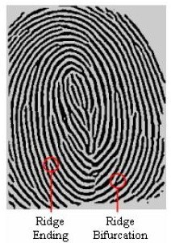
Among the variety of minutia types reported in literatures, two are mostly significant and in heavy usage:
1.Ridge ending- the abrupt end of a ridge
2.Ridge bifurcation- a single ridge that divides into two ridges

Slide 9
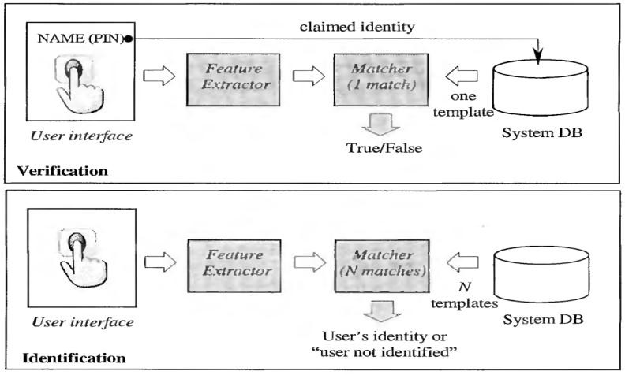
Fingerprint Recognition
It includes two sub-domains: one is fingerprint verification and the other is fingerprint identification.

Slide 10
Algorithms For Fingerprint Recognition
Capture Image.
Image Acquisition
Image Enhancement
Image Binarization
Preprocessing Stages
Image Segmentation
Thinning
Minutia Extraction
Minutiae Marking
Save Template in Database

Slide 11
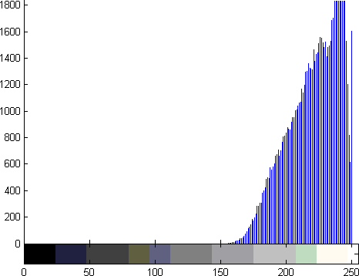
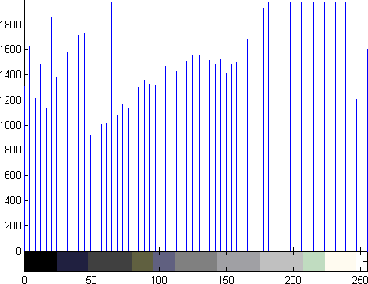
Image Enhancement
Histogram Equalization:
Histogram equalization is a technique of improving the global contrast of an image by adjusting the intensity distribution on
a histogram.
Original Histogram
Histogram After Equalization

Slide 12
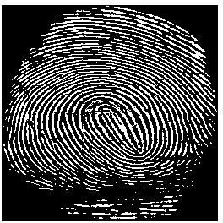
Image Binarization
Fingerprint Image Binarization is to transform the 8-bit Gray fingerprint image to a 1-bit image with 1-value for ridges and 0-value for furrows/valleys.
After the operation, ridges in the fingerprint are highlighted with white color while furrows are black .

Slide 13
Image Segmentation
In case of segmentation we basically partition a digital image in to multiple segments that is a set of pixels, It also well known as super pixels.
Typically image segmentation is used to locate the objects and boundaries like the lines and curves present in an images.

Slide 14
Minutiae Extraction
Ridge thinning:-
The ridge thinning process is used to eliminate the redundant pixels of ridges till the ridges are just up to one pixel wide. Then the thinned image is filtered.
Minutiae marking:-
After completion of fingerprint ridge thinning, minutiae marking is done by using 3 x3 pixel window as follows. In case of minutia marking the concept of Crossing Number (CN) is mainly used.

Slide 15
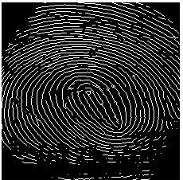
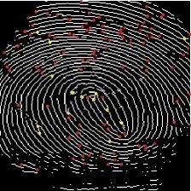
Minutiae Extraction
Thinned Image
Minutia Marked Image

Slide 16
Storage of Fingerprint Template into Database.
Base 64 encoding scheme is used to encode binary data that needs to be stored in MySQL database.
The generated fingerprint template is stored in MySQL fingerprint table along with User ID.

Slide 17
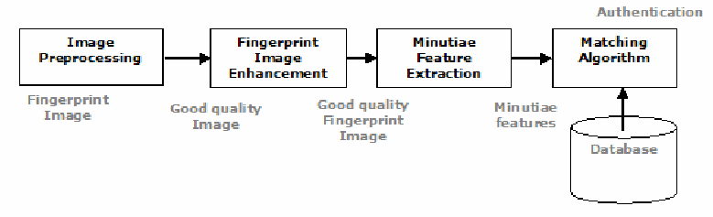
Fingerprint Verification

Slide 18
Important Performance Characteristics
False rejection is the situation when a biometric system is not able to verify the legitimate claimed identity of an enrolled person.
FRR = (FR/N)*100
Where FR is the number of false reject and N is the total number of verification.
False acceptance is a situation when a biometric system wrongly verified the identity by comparing biometric features from not identical individuals.
FAR = (FA/N)*100
Where FA is the number of false accept and N is the total number of verification
False Rejection Rate (FRR) refers to the statistical probability that the biometric system is not able to verify the legitimate claimed identity of an enrolled person, or fails to identify an enrolled person.
False Acceptance Rate (FAR) refers to the statistical probability of false Acceptance or incorrect verification. In the most common context, both False Rejection and False Acceptance represent a security hazard.

Slide 19
Required Hardware Software
Proposed hardware consists following parts:
(1)Fingerprint Scanner (Mantra MFS 100)
(2)Computer
Software used in this project:
(1) Xampp application server
(2) Sublime text editor
(3) Fingerprint module drivers

Slide 20
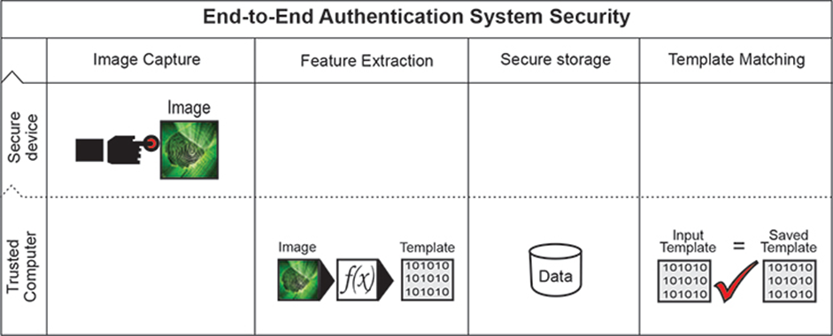
Fingerprint Scanner (Mantra MFS 100)
Lowest FAR and FRR.
Plug and play USB 2.0 high speed interface supports multiple devices handling.
500 dpi optical fingerprint sensor scratch free sensor surface.
Supports Windows 7,8,10, Windows Vista, Windows 2000, Windows Server 2003/2007/2008, Linux, Windows ME, Windows 98 SE SDK, Libraries and Drivers support across all above Platforms. (32 Bit and 64Bit)

Slide 21
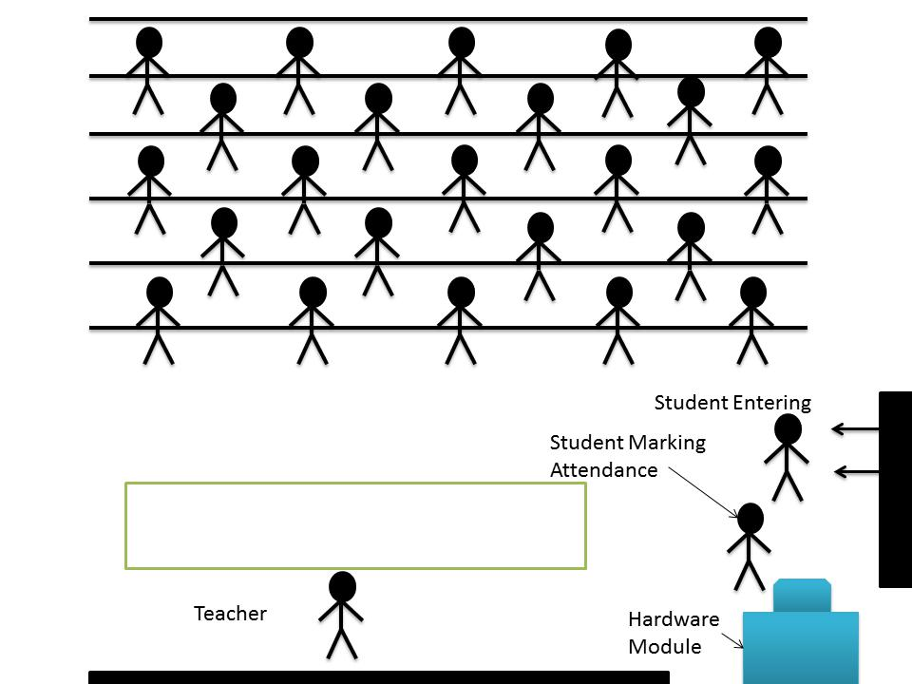
Attendance Scenario in Class

Slide 22





Fingerprint Attendance System
(Registration Process)
Registration
completed
Enter
details
Scan
Fingerprint
Database
Finger print scanner
PC
Notes:
R305

Slide 23
Fingerprint Attendance System
(Verification Attendance)
Match
Found
Attendance updated
Database
Finger print scanner
PC
Notes:
R305

Slide 24
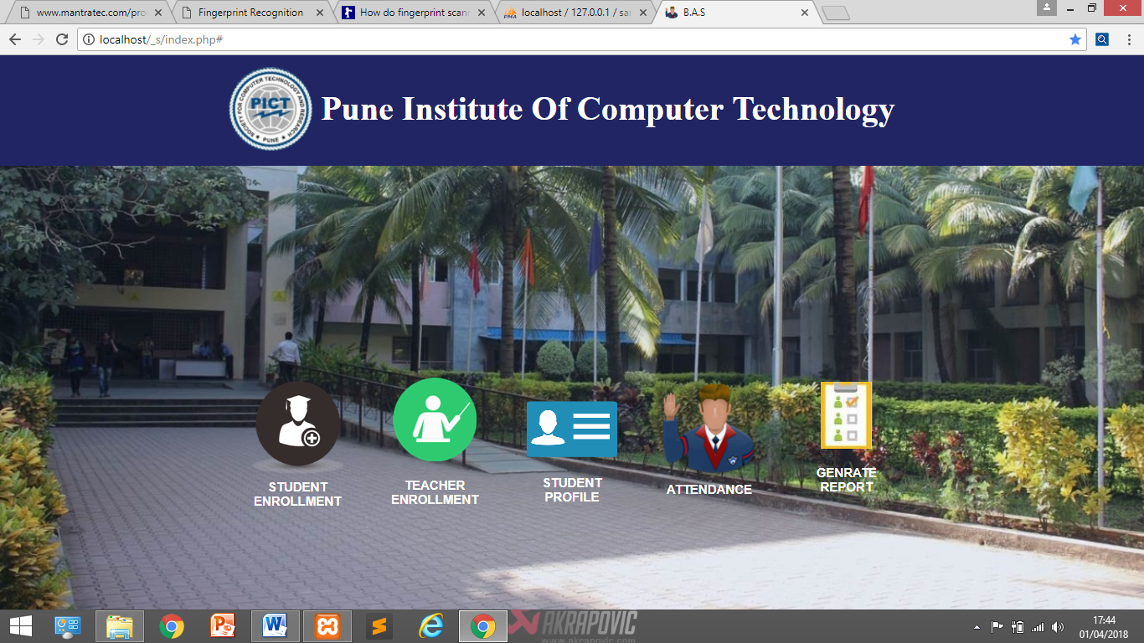
System UI

Slide 25
Outcomes of this Project
An applicable attendance management system was designed for educational organizations.
We studied fingerprint enrollment and verification process.
We learnt about DBMS and have successfully installed XAMPP application on the PC.
Most important database management language i.e. SQL is studied and database of different entities is implemented in MySQL.
We have learnt about Web development and HTML to create the Webpages: Also, installing of apache server is studied and implemented successfully.
Skills and self-confidence in coding and working with software's like Xampp Application were developed.

Slide 26
CONCLUSION
This project mainly comprised of development of student attendance management system with the help of fingerprint verification system.
We learnt about DBMS and have successfully installed XAMPP application on the PC.
This project represents a framework using which attendance management can be made automated and on-line.
We have designed and implemented database for attendance system using MySQL.
We have learnt fingerprint recognition process, based on minutia extraction of fingerprint image.
The template generated in fingerprint recognition system is successfully stored and retrieved from database.
The developed system is more efficient and time saving than the old traditional attendance taking method.

